Slide 1
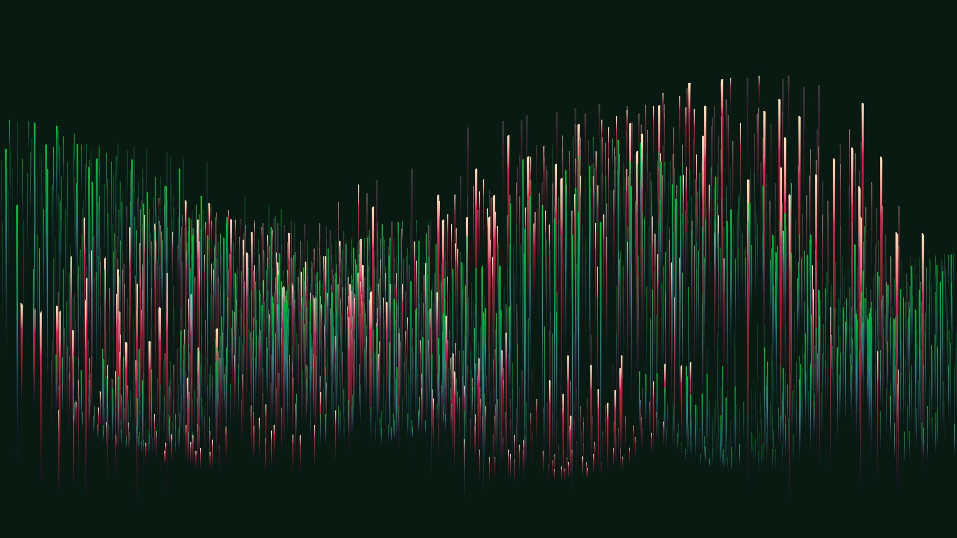
10 Stages of Game Development: The Lost Temple
Andrew Cornell

Slide 2
#1: Brainstorming
Brainstorming always the first and typically one of the most important stages in development
I first thought about which genres of games I enjoyed and would have the most fun developing
After I decided my genre, I thought about a theme. The Indiana Jones style setting is a classic.
I have always loved puzzles of all sorts, so I decided I wanted to implement puzzle solving into the game.
Critical components
Game Title: The Lost Temple
Genre: 2d Platformer
Setting: Ancient Ruins
Characters: Archaeologist
Background Story: Searching for treasure
Platforms: PC
Target Audience: Everyone

Slide 3
#2: Initial Design
Level Design: Level design in platformers is the life of the game
Art Style: I love pixel art style videogames so I thought implementing a pixel art theme would be perfect
Mechanics: Typical platformer mechanics with running, jumping and collecting.
Game Objective: Reach end of level by dodging obstacles and collecting gems.
GDD Components:
Text
Diagrams
Sketches
Artwork
Photos
Charts
Tables
Lists

Slide 4

#3: Prototyping
Prototype is a draft, miniature version of the game
Prototype is to a game as a sketch is to a painting
No assets included
Barebones version
In this stage, you can really see the game start to take shape
Prototype completion achievements
Appraisal of workload
Troubleshooting
Visualization

Slide 5
#4: Refining Design
Think about changes
Make the changes
Judge the changes
Take outcome of prototype to refine the game
Done in an iterative process
After prototyping I was was able to refine my game by tweaking player settings, level adjustments and addressing bugs.

Slide 6
#5: Asset Creation
Tips I used:
Recycle assets
Use photo references
Outsource workload
Assets refer to all game graphics and animations
Typically, the longest and most expensive stage
For asset creation in The Lost Temple, I used free assets on the Unity Store and modified some using Pixilart.com
Learned to use Unity’s 2d tilemap creator.

Slide 7
#6: Importing Assets
Assets must be imported from creation software to Unity game engine
Requires lots of tweaking and setup
Aren’t guaranteed to look or perform well during gameplay
File formats and compatibility
Asset Requirements

Slide 8
#7: Level Design
Use the modular method
1
Design levels with a plan
2
Test your levels on others
3
Level design is critical to keeping players engaged
Ultimate purpose is to create a world for the user to exist in
Went through iterations of playtesting and refining the design.

Slide 9

#8: Scripting
Scripting works hand in hand with level design
Controls how the environment behaves
Using C# is how I was able to bring the game to life
Scripting is the key to smooth gameplay
Debugging is a big part of scripting.
Use code comments

Slide 10
#9: Testing
Test early
Use version numbers
Track bugs
Make sure the game behaves according to design and cannot be broken
When testing, play with the intention of breaking the game.
Iterative stages

Slide 11
#10: Building
Tailor
Tailor builds to platforms
Unity allows you to deploy games to specific platforms
Understand
Understand your target hardware
Allows you to benchmark your game
Review
Play the game build and make sure everything turned out as expected.

Slide 12
Sources used for development
Tutorial used to start project: https://www.youtube.com/watch?v=TcranVQUQ5U&list=PLgOEwFbvGm5o8hayFB6skAfa8Z-mw4dPV
Tutorial used for learning Unity 2d Tilemap: https://www.youtube.com/watch?v=QkbGr1rAya8&list=PLrnPJCHvNZuCVTz6lvhR81nnaf1a-b67U&index=2

